Slide 1
Bias-Variance Tradeoff
Aksadur Rahman
aksadur@yahoo.com

Slide 2
Bias-Variance

Slide 3

Bias-Variance

Slide 4
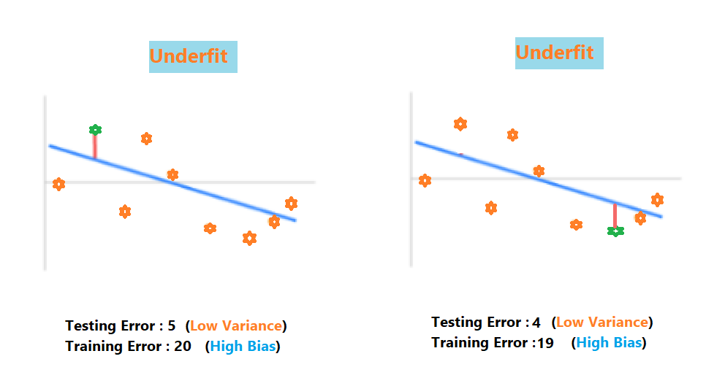
Bias-Variance

Slide 5
Bias-Variance
Sweet spot

Slide 6
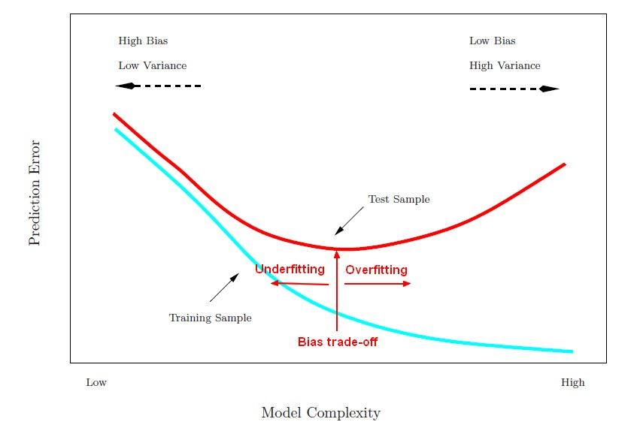
Bias-Variance

Slide 7
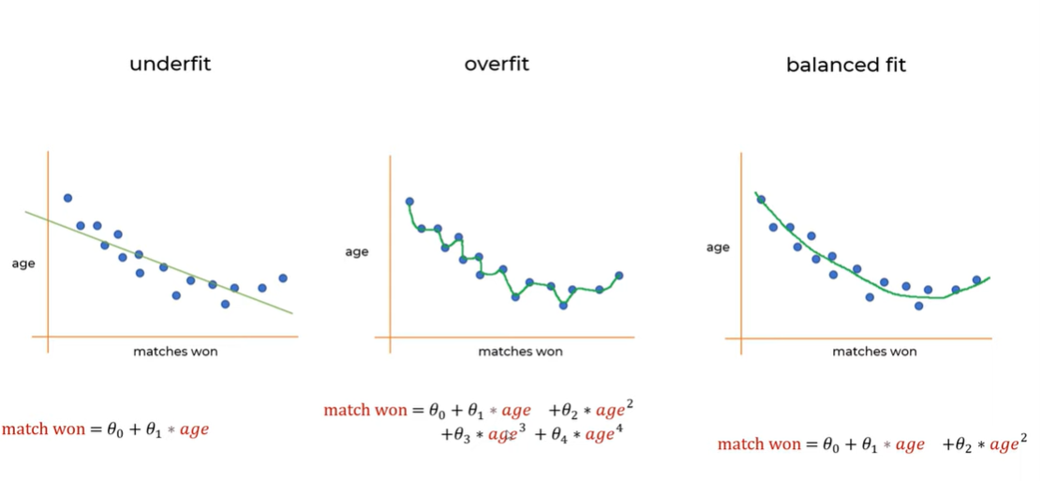
Bias-Variance

Slide 8
Bias-Variance Tradeoff
Choose appropriate algorithm.
Reduce dimensions.
Reduce error.
Use regularization techniques.
Use ensemble models, bagging, resampling, etc.

